Slide 1
Object-Oriented Programming Using C#

Slide 2


Objectives
In this session, you will learn to:
Implement threads
Define the life cycle of a thread
SSDN

Slide 3
Implementing Threads
What are threads?
SSDN

Slide 4


Implementing Threads
The designer of the battlefield game shows the explosion by making the huts disappear, showing the smoke, and playing the sound of the explosion at the same time. He is able to achieve this by using threads.
SSDN

Slide 5

Implementing Threads
Thread is the basic unit to which an operating system allocates processor time. It is an independent execution path within a program.
You can perform multiple tasks at the same time by using threads in the program.
A process that is executed using one thread is known as a single-threaded process.
The following figure shows a single-threaded process.
SSDN

Slide 6
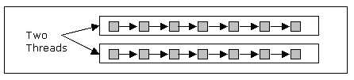
Implementing Threads
A process that creates two or more threads is called a multithreaded process.
The following figure shows a multithreaded process with two threads.
SSDN

Slide 7
Implementing Threads
In single-threaded systems, an approach called event loop with polling is used.
Polling is the process in which a single event is executed at a time.
In the event loop with polling approach, a single thread runs in an infinite loop till its operation is completed.
When the operation is completed, the event loop sends the control to the appropriate event handler.
Multithreading is used in software that require user interaction and require a quick response to the user's activities.
SSDN

Slide 8
Implementing Threads
In C#, you use the Thread class to work with threads.
The System.Threading.Thread class is used to construct and access individual threads in a multithreaded application.
The first thread to be executed in a process is called the main thread.
You can access the main thread of the program by using the CurrentThread property of the Thread class.
You can create other threads in the program by using the Thread class. Such threads are called child threads.
SSDN

Slide 9
Implementing Threads
The following code shows referencing the main thread by using the CurrentThread property of the Thread class:
using System;
using System.Threading;
namespace ThreadExample
{
class MainThreadExample
{
public static void Main(string[] args)
{
Thread Th = Thread.CurrentThread;
Th.Name = "MainThread";
SSDN

Slide 10
Implementing Threads
Console.WriteLine("The current thread after name change :{0}", Th.Name);
Console.ReadLine();
}
}
}
SSDN

Slide 11
Working with Threads
How can I work with threads?
SSDN

Slide 12
Working with Threads
In C#, you can create a thread by creating an object of the Thread class.
You can use various methods available with the Thread class to control the execution of threads.
Some methods available with the Thread class are:
Start(): Starts a thread.
Sleep(): Makes the thread to pause for a period of time.
Abort(): Terminates the thread.
Suspend(): Suspends a thread. If the thread is already suspended, it has no effect.
Resume(): Resumes the suspended thread.
SSDN

Slide 13
Working with Threads
The following code shows the creation of a thread by using the Thread class:
using System;
using System.Threading;
namespace ThreadSample
{
class BasicThreadApp
{
public static void ChildThreadCall()
{
Console.WriteLine("Child thread started");
}
SSDN

Slide 14
Working with Threads
public static void Main()
{
ThreadStart ChildRef = new ThreadStart(ChildThreadCall);
Console.WriteLine("Main - Creating Child thread");
Thread ChildThread = new Thread(ChildRef);
ChildThread.Start();
Console.WriteLine("Main - Have requested the start of child thread");
Console.ReadLine();}
}
}
The ThreadStart keyword specifies the method to be invoked by the thread.
SSDN

Slide 15
Working with Threads
When you require the thread to pause for a period of time so that another thread is allowed to execute, you can call the Thread.Sleep() method.
The following code shows the usage of the Sleep() method:
using System;
using System.Threading;
namespace ThreadSample
{
class BasicThreadApp
{
public static void ChildThreadCall()
{
Console.WriteLine("Child thread started");
SSDN

Slide 16
Working with Threads
int SleepTime = 5000;
Console.WriteLine("Sleeping for {0} seconds",SleepTime/1000);
Thread.Sleep(SleepTime); //Sleep for five //seconds
Console.WriteLine("Waking Up");
}
public static void Main()
{
ThreadStart ChildRef = new ThreadStart(ChildThreadCall);
Console.WriteLine("Main - Creating Child thread");
SSDN
Notes:
16

Slide 17
Working with Threads
Thread ChildThread = new Thread(ChildRef);
ChildThread.Start();
Console.WriteLin("Main - Have requested the start of child thread");
Console.ReadLine();
}
}
}
SSDN
Notes:
17

Slide 18
Working with Threads
You can call Thread.Sleep() method with a value 0, which will cause the current thread to hand over the unused balance of its timeslice.
You can also call the Thread.sleep() method with the parameter as Timeout.Infinite to put the current thread to sleep infinitely.
The sleeping thread can be resumed by calling the Interrupt() method of the Thread class.
SSDN

Slide 19
Working with Threads
The following figure shows the paused and resumed states of a sleeping thread.
Running/Resumed
Interrupt()
Sleep()
Paused
SSDN

Slide 20
Working with Threads
You can suspend the execution of a thread by using the Thread.Suspend()method.
When a thread is suspended, only another thread can cause its resumption, by using the Thread.Resume() method.
The thread can be destroyed by using the Thread.Abort() method.
The exception, ThreadAbortException, is thrown when the thread is destroyed.
If the finally block is present in the method, the runtime will send the control to it.
SSDN

Slide 21
Working with Threads
The following code shows the use of the Thread.Abort() method:
using System;
using System.Threading;
namespace ThreadSample
{
class BasicThreadApp
{
public static void ChildThreadCall()
{
try
{
Console.WriteLine("Child thread started");
Console.WriteLine
SSDN

Slide 22
Working with Threads
("Child thread - counting to 10");
for (int i = 0; i < 10; i++)
{ Thread.Sleep(500);
Console.Write("{0}...", i);
}
Console.WriteLine("Child thread finished");
}
catch (ThreadAbortException e)
{ Console.WriteLine("Exception"); }
finally
{ Console.WriteLine("Child thread -Unable to catch the exception.");
}
}
SSDN

Slide 23
Working with Threads
public static void Main()
{
ThreadStart ChildRef = new ThreadStart(ChildThreadCall);
Console.WriteLine("Main - Creating Child thread");
Thread ChildThread = new Thread(ChildRef);
ChildThread.Start();
//Give the Child thread time to start
Console.WriteLine("Main-Sleeping for 2 seconds");
Thread.Sleep(2000);
Console.WriteLine("\n Main - Aborting Child thread");
ChildThread.Abort();
SSDN

Slide 24
Working with Threads
Console.ReadLine();
}
}
}
SSDN

Slide 25
Implementing Thread Life Cycle
What is a thread life cycle?
SSDN

Slide 26
Implementing Thread Life Cycle
The lifecycle of a thread starts when an object of the System.Threading.Thread class is created.
The life cycle of the thread ends when the task is completed.
The various states in the life cycle of a thread are:
The Unstarted state
The Runnable state
The Not Runnable state
The Dead state
SSDN

Slide 27
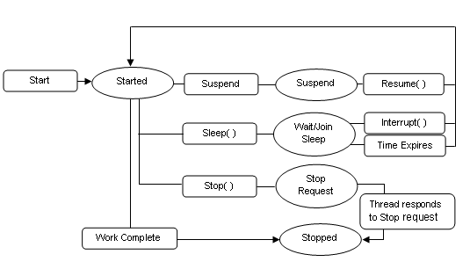
Implementing Thread Life Cycle
The following figure shows the various thread states and methods, which can cause the thread to move from one state to another.
SSDN

Slide 28
The Unstarted State
When an instance of the Thread class is created, the thread enters the unstarted state.
A new thread is an empty object of the Thread class, and no system resources such as memory are allocated to it.
You have to invoke the Start() method to start the thread.
SSDN

Slide 29
The Runnable State
The thread remains in the unstarted state until the program calls the Start() method of the Thread class.
The Start() method places the thread in the runnable state.
This state is also called the ready or started state.
The newly started thread and any other threads in the program execute at the same time.
SSDN

Slide 30
The Not Runnable State
A thread is not in the runnable state if it is:
Sleeping : A thread is put into the sleeping mode by calling the Sleep() method.
Waiting : A thread can be made to wait for some specified condition to be satisfied by calling the Wait() method.
Blocked : A thread can be blocked by an I/O operation. When the thread is blocked, it enters the not runnable state.
SSDN
Notes:
Student already have learnt about type 2 SCDs in Module I. Therefore, you can start this topic by asking the following questions to students:
What are type 2 SCDs?
Given an example to explain type 2 SCDs.
This will recapitulate what they have learnt about type 2 SCD in Module 1.
Now explain the strategy to update the data into these dimension tables with help the example given in SG.
After explaining the examples, you can ask students to think of an example of a type 2 SCD and then tell the strategy to update the data into this dimension table.

Slide 31
The Dead State
A running thread enters the dead state when the statements of the threads method are complete. This state is also called the terminated state.
A program can force a thread into the dead state by calling the Abort() method of the Thread class on the appropriate thread object.
SSDN

Slide 32
Introducing Multithreading
Multithreading helps to perform various operations at the same time.
Multithreading allows you to achieve multitasking in a program.
Multitasking is the ability to execute more than one task at the same time.
SSDN

Slide 33
Introducing Multithreading
The lady is eating an apple, reading a book, and working on a computer simultaneously.
SSDN

Slide 34
Introducing Multithreading
Multitasking can be divided into the following categories:
Process-based multitasking: Executing multiple programs at the same time.
Thread-based multitasking: Executing multiple threads within a single program.
SSDN

Slide 35
Advantages and Limitations of Multithreading
The advantages of multithreading are:
Improved performance
Minimized system resource usage
Access to multiple applications at the same time
Program structure simplification
SSDN

Slide 36
Advantages and Limitations of Multithreading
The limitations of multithreading are:
Race condition
Deadlock condition
Lock starvation
SSDN

Slide 37
Creating Multiple Threads
You can create multiple threads in a program by using the Thread class.
The following program shows the creation of multiple threads by using the Thread class:
using System;
using System.Threading;
class ThreadSchedule
{
public static void ChildThread1()
{
Console.WriteLine("Child thread 1 started");
Console.WriteLine("Child thread - counting from 1 to 10");
SSDN

Slide 38
Creating Multiple Threads
for (int T = 1; T < 11; T++)
{
for (int Cnt = 0; Cnt < 100; Cnt++)
{
Console.Write(".");
}
Console.Write("{0}", T);
}
Console.WriteLine("Child thread 1 finished");
}
public static void ChildThread2()
{
Console.WriteLine("Child thread 2 started");
SSDN

Slide 39
Creating Multiple Threads
Console.WriteLine("Child thread - counting slowly from 11 to 20");
for (int T = 11; T < 20; T++)
{
for (int Cnt = 0; Cnt < 100; Cnt++)
{
Console.Write(".");
// Code to imitate work being done
}
Console.Write("{0}", T);
}
Console.WriteLine("Child thread 2 finished");
}
SSDN

Slide 40
Creating Multiple Threads
public static void Main()
{
ThreadStart Child1 = new ThreadStart(ChildThread1);
ThreadStart Child2= new ThreadStart(ChildThread2);
Console.WriteLine("Main - Creating Child threads");
Thread Thread1 = new Thread(Child1);
Thread Thread2 = new Thread(Child2);
Thread1.Start();
Thread2.Start();
}
}
SSDN

Slide 41
Identifying the Thread Priority
One of the attributes that controls the behavior of a thread is its priority.
The .NET Run-time Environment executes threads based on their priority.
The threads are fixed-priority scheduled.
Each prioritized thread has its position in the thread queue of the processor.
SSDN

Slide 42
Defining Thread Priority
Thread priority is the property that specifies the priority of one thread with respect to the priority of another thread.
Thread priority can be defined as:
Above normal
Below normal
Highest
Lowest
Normal
A thread with higher priority runs before threads, which have lower priority.
If C# encounters another thread with higher priority, the current thread is pushed back; and the thread with the higher priority is executed.
SSDN

Slide 43
Setting the Thread Priority
You can set the thread priority after it is created using the Priority property of the Thread class.
The following syntax shows how to set the thread priority:
NewThread.Priority = ThreadPriority.Highest;
SSDN

Slide 44
Setting the Thread Priority
If multiple threads with the same priority are available, the scheduler gives each thread a fixed time slice in which they execute.
As long as a thread with a higher priority is available to run, lower priority threads do not get chance to execute.
When there are no more runnable threads at a given priority, the scheduler moves to the next lower priority and schedules the threads at that priority for execution.
SSDN

Slide 45
Setting the Thread Priority
The following code shows the execution of two child threads with different priorities:
using System;
using System.Threading;
class ThreadSchedule
{
public static void ChildThread1()
{
Console.WriteLine("Child thread 1 started");
Console.WriteLine("Child thread - counting from 1 to 10");
for (int T = 1; T < 11; T++)
{
for (int Cnt = 0; Cnt < 100; Cnt++)
SSDN

Slide 46
Setting the Thread Priority
{
Console.Write(".");
// Code to imitate work being done
}
Console.Write("{0}", T);
}
Console.WriteLine("Child thread 1 finished");
}
public static void ChildThread2()
{
Console.WriteLine("Child thread 2 started");
Console.WriteLine("Child thread - counting from 11 to 20");
for (int T = 11; T < 20; T++)
{
SSDN

Slide 47
Setting the Thread Priority
for (int Cnt = 0; Cnt < 100; Cnt++)
{
Console.Write(".");
// Code to imitate work being done
}
Console.Write("{0}", T);
}
Console.WriteLine("Child thread 2 finished");
}
public static void Main()
{
ThreadStart Child1 = new ThreadStart(ChildThread1);
ThreadStart Child2 = new ThreadStart(ChildThread2);
Console.WriteLine("Main - Creating Child threads");
SSDN

Slide 48
Setting the Thread Priority
Thread Thread1 = new Thread(Child1);
Thread Thread2 = new Thread(Child2);
Thread1.Priority = ThreadPriority.Highest;
Thread2.Priority = ThreadPriority.Lowest;
Thread1.Start();
Thread2.Start();
}
}
SSDN

Slide 49
Objectives
In this session, you will learn to:
Use synchronization in threads
Identify communication between processes
Declare delegates
Instantiate delegate
SSDN

Slide 50
Using Synchronization in Threads
In a multithreaded application, when threads need to share data with each other, the application should ensure that one thread does not change the data used by the other thread.
Let us take an example to understand this.
SSDN

Slide 51
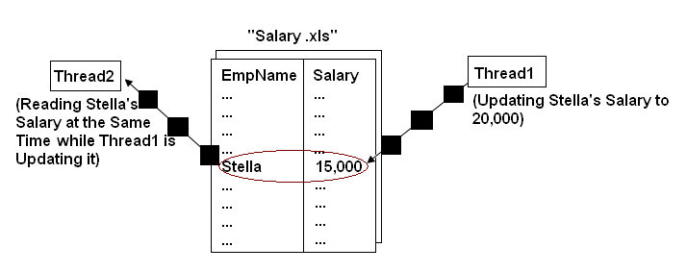
Using Synchronization in Threads
The following figure shows two threads accessing the data of a file at the same time.
!
The data might get corrupted.
SSDN

Slide 52
Synchronizing Threads
Synchronization of threads ensures that if two or more threads need to access a shared resource then that resource is used by only one thread at a time.
You can synchronize your code using the synchronized keyword.
Synchronization is based on the concept of monitoring.
A monitor is an object that is used as a lock to the data members and methods of a class.
When a thread gets a lock, it is said to have entered the monitor.
When a thread is within a synchronized method, all the other threads that try to call the method on the same instance have to wait.
SSDN

Slide 53

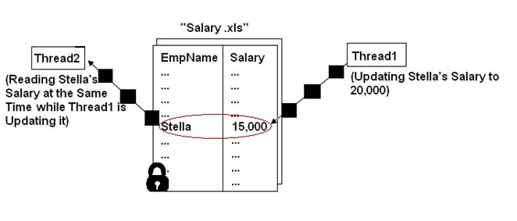
Synchronizing Threads
The following figure shows thread synchronization.
SSDN

Slide 54
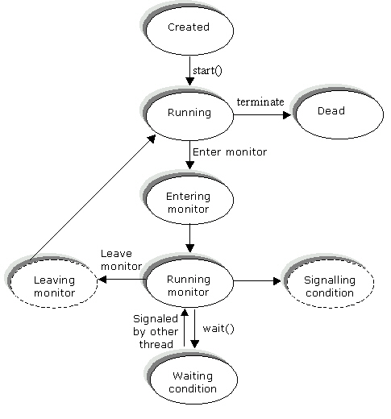
Synchronizing Threads
The following figure shows synchronization among threads.
SSDN

Slide 55
Synchronizing Threads
The following code locks the WriteData() method by using the Monitor.Enter() method:
using System;
using System.Threading;
namespace ThreadExample
{
class FileAccess
{
public void WriteData(string Data)
{
Monitor.Enter(this);
Console.WriteLine("FileAccess.WriteData - Started");
Console.WriteLine("FileAccess.WriteData - Working");
SSDN

Slide 56
Synchronizing Threads
for (int Cnt = 0; Cnt < 100; Cnt++)
{
Console.Write(Data);
}
Console.WriteLine("FileAccess.WriteData - Ended");
Monitor.Exit(this);
}
}
class ThreadMonitorClass
{
public static FileAccess Fd = new FileAccess();
public static void ChildThread1()
{
SSDN

Slide 57
Synchronizing Threads
Console.WriteLine("Child thread #1 - Started");
Console.WriteLine("Child thread #1-Calling FileAccess.WriteData");
Fd.WriteData("T1");
Console.WriteLine("Child thread #1 - Returned from Output");
}
public static void ChildThread2()
{
Console.WriteLine("Child thread #2 - Started");
Console.WriteLine
("Child thread #2 - Calling FileAccess.WriteData");
Fd.WriteData("T2");
Console.WriteLine("Child thread #2 - Returned from Output");
SSDN

Slide 58
Synchronizing Threads
Console.WriteLine("Child thread #1 - Started");
Console.WriteLine("Child thread #1-Calling FileAccess.WriteData");
Fd.WriteData("T1");
Console.WriteLine("Child thread #1 - Returned from Output");
}
public static void ChildThread2()
{
Console.WriteLine("Child thread #2 - Started");
Console.WriteLine
("Child thread #2 - Calling FileAccess.WriteData");
Fd.WriteData("T2");
Console.WriteLine("Child thread #2 - Returned from Output");
SSDN

Slide 59
Synchronizing Threads
The following code locks the WriteData() method by using the Lock statement:
using System;
using System.Threading;
namespace ThreadExample
{
class FileAccess
{
public void WriteData(string Data)
{
lock (this)
{
Console.WriteLine("FileAccess.WriteData - Started");
SSDN

Slide 60
Synchronizing Threads
Console.WriteLine("FileAccess.WriteData - Working");
for (int Cnt = 0; Cnt < 100; Cnt++)
{
Console.Write(Data);
}
Console.WriteLine("FileAccess.WriteData - Ended");
}
}
}
class ThreadLockClass
{
public static FileAccess Fd = new FileAccess();
public static void ChildThread1()
{
SSDN

Slide 61
Synchronizing Threads
Console.WriteLine("Child thread #1 - Started");
Console.WriteLine("Child thread #1 - Calling FileAccess.WriteData ");
Fd.WriteData("T1");
Console.WriteLine("Child thread #1 - Returned from Output");
}
public static void ChildThread2()
{
Console.WriteLine("Child thread #2 - Started");
Console.WriteLine ("Child thread #2 - Calling FileAccess.WriteData ");
Fd.WriteData("T2");
Console.WriteLine("Child thread #2 - Returned from Output"); }
SSDN

Slide 62
Synchronizing Threads
public static void Main()
{
ThreadStart Child1 = new ThreadStart(ChildThread1);
ThreadStart Child2 = new ThreadStart(ChildThread2);
Console.WriteLine("Main - Creating Child threads");
Thread Thread1 = new Thread(Child1);
Thread Thread2 = new Thread(Child2);
Thread1.Start();
Thread2.Start();
Console.ReadLine();
}
}
}
SSDN

Slide 63
Identifying Communication Between Processes
A process is a running instance of a program.
The communication between the processes at run time within the same computer or over a network is called the inter-process communication.
The Operating System (OS) manages the memory of the system that is used by various processes to communicate with each other.
SSDN

Slide 64
Application Domain
When an application runs, a new application domain is created.
An application domain separates one application from another application by acting as a container for each application.
In .NET, threads execute in an application domain.
A thread in one process cannot invoke a method in a thread that belongs to another process.
In .NET, however, threads can cross the application domain boundaries, and a method in one thread can call a method of another application domain.
SSDN

Slide 65
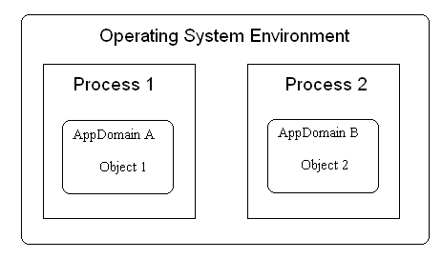
Application Domain
The following figure shows application domains interacting with each other.
SSDN

Slide 66
Application Domain
The main purpose of the application domain is to separate an application from the other applications. Application domains run on a single process.
You use the System.AppDomain class to manage application domains.
SSDN

